Slide 1
What does it take to detect risk genes for psychiatric disorders?
Susan L Santangelo, ScD
Director, Psychiatric Research
Maine Medical Center Research Institute
Member Psychiatric Genomics Consortium
(Cross Disorder and Autism Work Groups)

Slide 2
Psychiatric Genomics Consortium
Purpose: conduct meta-analyses of genome-wide association (GWAS) data for psychiatric disease (www.med.unc.edu/pgc)
Includes > 500 investigators, 80 institutions in 25 countries
  Largest consortium in the history of psychiatry Largest biological experiment in psychiatry
3 Specific Aims:
  1) Disorder-specific meta-analyses
  2) Cross-disorder analyses
  3) Comorbidity meta-analyses

Slide 3
Psychiatric Genomics Consortium
Began 2007, then quickly grew to a compendium of GWAS data and samples from over 61,000 individuals who are either normal controls or
  carry a diagnosis of one of five psychiatric disorders:
    ADHD
    autism
    bipolar disorder
    major depressive disorder
    schizophrenia
Number of samples currently in analysis = 170,000

Slide 4
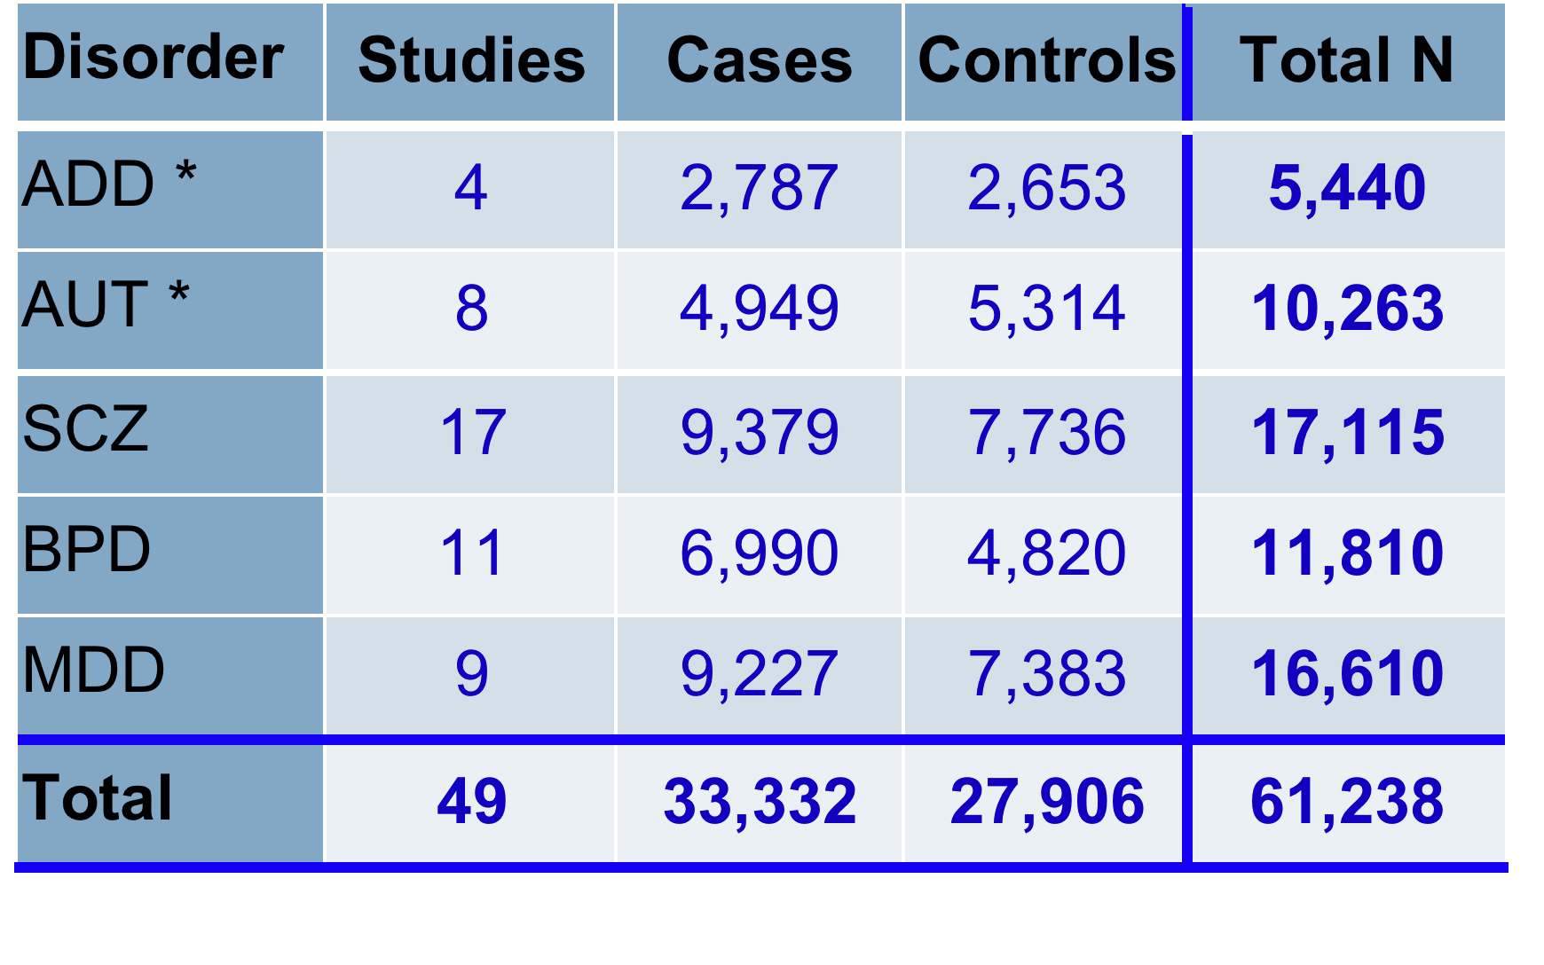
PGC Cross-Disorder GWAS Meta-Analysis
1.2 million SNPs
Cross-Disorder Group of the Psychiatric GWAS Consortium. Genome-wide Analysis Identifies Loci With Shared Effects on Five Major Psychiatric Disorders. The Lancet 01/2013; 381(9875):1371-1379

Slide 6
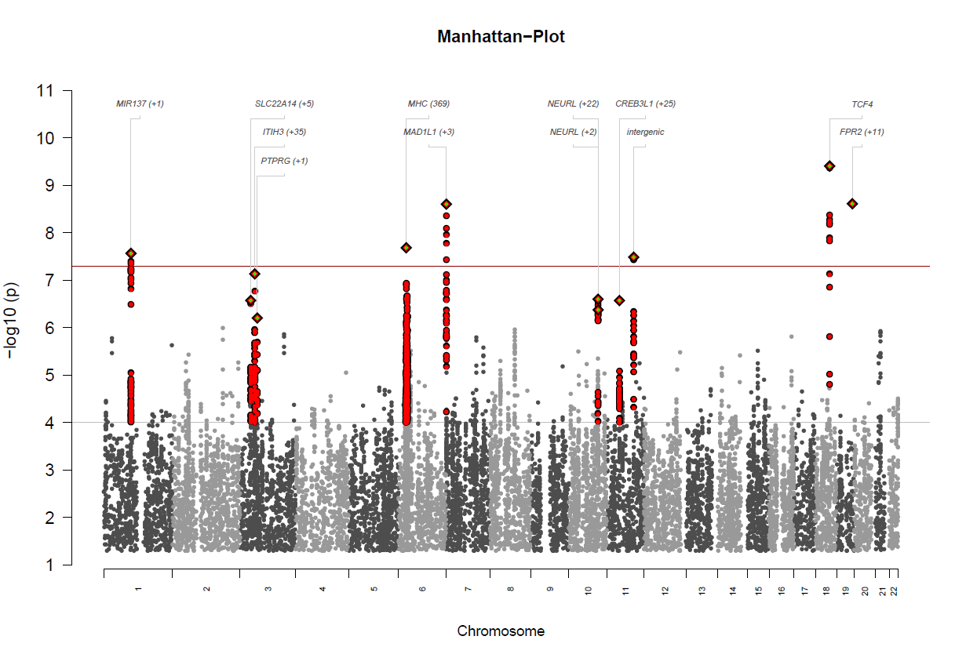
ASD-SCZ Results

Slide 7
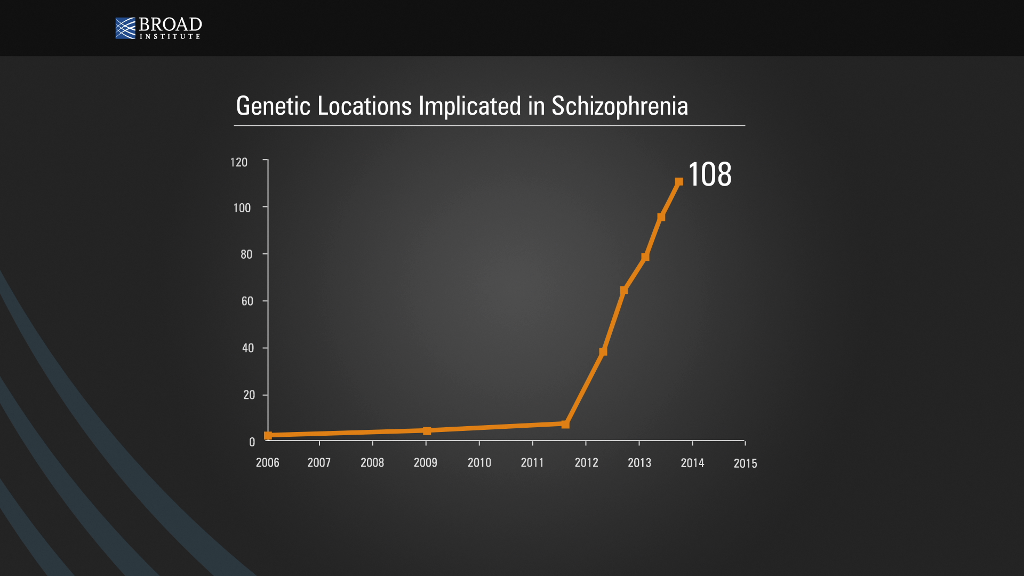
128 independently associated SNPs in 108 genomic loci
    Sample size = 37,000 cases and 113,000 controls
Schizophrenia Working Group of the Psychiatric Genomics Consortium. 2014. Nature..

Slide 8
Lessons from PCG Cross-Disorder GWAS
Genuine biological clues beginning to emerge from common variation
  Calcium channel genes
  miR-137 and targets (e.g. TCF4, CACNA1C ) neurogenesis/neuronal maturation
Like CNVs, many common SNP associations do not respect traditional clinical definition boundaries
  e.g., some SNPs shared by all 5 psychiatric dxes

Slide 9
Large samples are required!
All psychiatric dxes are highly polygenic
  involving hundreds of genes
Polygenicity is characteristic of most complex biomedical diseases
  e.g., bipolar disorder, schizophrenia, type 1 and type 2 diabetes, Crohn’s disease, rheumatoid arthritis, coeliac disease, coronary artery disease, etc., etc.
Although common variation is important
  Each gene exerts very small effect so very large samples are needed to detect them

Slide 10
Pathways and Pleiotropy
Most genetic variants identified not specific to any disorder: Pleiotropy is true for most
  one gene mutation results in multiple phenotypes
Numbers of pathway analyses show a clear convergence of rare exonic variants, structural variants, common variants, and miRNAs on a few key biological pathways involved in:
  brain development,
  synapse function and
  chromatin regulation/remodeling

Slide 11
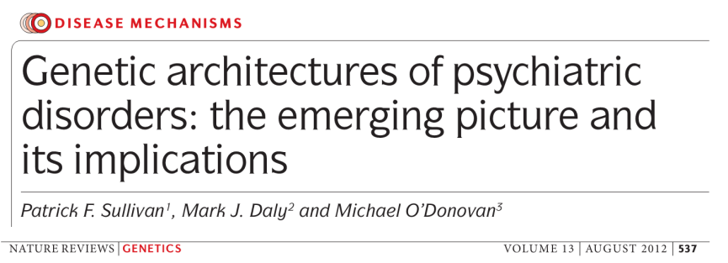
Pathway interventions?
This is not necessarily a bad thing!
  Possible that risk might be conferred by properties of the pathways themselves rather than by any single component
If true - might it be easier to try to manipulate a dysfunctional pathway into normal range than to replace/fix mutated component parts?

Slide 12


Acknowledgements
PGC Cross-Disorder Working Group
Nick Craddock
Ken Kendler
Phil Lee
Ben Neale
John Nurnberger
Stephan Ripke
Jordan Smoller
Patrick Sullivan
… and others
PGC Autism Working Group
Richard Anney
Dan Arking
Ed Cook
Mark Daly
Bernie Devlin
Michael Gill
Stephan Ripke
Jim Sutcliffe
… and others
Maine Medical Center
Matt Siegel
Kahsi Smith
Christine Peura
Deanna Williams
Amanda Rago
Most importantly – All the people with
psychiatric disorders and their families who participate in research!
Simons Foundation
***
NLM Family Foundation

Slide 13
CA+ Channel Signaling Genes
CACNA1C: encodes an alpha-1C subunit of an L-type, voltage-dependent calcium channel protein
  On chromosome 12p13.33
  Mutations cause Timothy syndrome characterized by
    multiorgan dysfunction, lethal arrhythmias, webbed fingers and toes, congenital heart disease, immune deficiency, intermittent hypoglycemia, cognitive abnormalities, and autism
Calcium channels mediate the influx of calcium ions into the cell upon membrane polarization
A predicted target of miR-137

Slide 14
TCF4
On chromosome 18q21.2
  20 exons (2 noncoding), spans 360 kb, with multiple isoforms
Encodes a protein acting as a transcription factor
  Involved in initiation of neuronal differentiation
  Expressed mostly in brain in developing embryonic tissues
Causes Pitt-Hopkins syndrome
  Autism is one phenotypic manifestation
Known association with schizophrenia
Another predicted target of miR-137

Slide 15
miR-137
A short non-coding micro-RNA
  located on chromosome 1p22
Strongest signal in PGC SCZ GWAS meta analysis
Thought to regulate TCF4 and CACNA1C
Regulates dendritic development, neuron maturation
Overexpression of miR-137 inhibits dendritic morphogenesis, phenotypic maturation, and spine development
  in both brain and cultured primary neurons

